Slide 1
BASIC INFORMATION FOR NEW TENANTS
LETIŠTĚ PRAHA, A. S.
www.prg.aero

Slide 2
Content
AIRPORT IDENTIFICATION CARDS
CONSTRUCTION WORKS
ELECTRICITY
IT SERVICES
STORE STOCKING
WASTE MANAGEMENT
ADDITIONAL IMPORTANT INFORMATION
LIST OF ATTACHEMENTS - FORMS AND MANUALS

Slide 3
Airport Identification Card (Airport IDC)
To obtain an Airport IDC you will need:
Background Check Certificate
Application for Check Certificate shall be made by electronic application at the web page of Civil Aviation Authority of the Czech Republic
Background check usually takes at least 40-50 days from the date of its submitting. Obtained Certificate must be presented whilst you are attending the Security Training at Prague Airport.
Certificate of Security Training issued by Prague Airport (hereinafter „PA“)
In order to obtain the Certificate of Security Training you must register your company into the PA online booking portal at: https://www.skoleni-lp.cz and book a training date for your employees to a relevant security training.
Do not forget to bring with you the original of your Background Check Certificate to the PA security training
(Please book your employes for the security training for a date approx. 30 days from the date of application for the Background Check Certificate or check with the Civil Aviation Authority about the current status of the application before booking the security training date).
Authorized Person appointed by your company – registration to PA database of authorized persons
In order to be able to apply for Airport IDC and thus gain access to the Team Assistant System (TAS) in which these applications or applications for single entry permissions etc. are made, you must fill in the form called „Application for Signature Authorization“ (see attachment „Žádost o podpisové oprávnění) for the persons who will be appointed by you to submit these applications on behalf of your company. The form must be delivered to the Security Administration Office of PA. Security Administration Office is located between the Terminal 1 and Terminal 2)
Application for the Airport IDC by Authorized Person
Your Authorized Person is allowed to apply for the Airport IDC for your employees via TAS system. When filling in the form for Airport IDC, please do not forget to fill in also the number of Commercial Activities Guarantor for approval of your applications on behalf of the Commercial Activities Department (below you will find the list of persons appointed as guarantors by Commercial Activities Department and their guarantor numbers).
You will be notified of the approval of the application for Airport IDC by the Security Administration Office. Documents needed to present when collecting the Airport IDC:
Background Check Certificate
Certificate of Security Training
Your Identity Card or Passport (foreign citizens can use only passports)
Pay the fee for the issuance of the Airport IDC according to the PA Service Price List. Payments are possible in cash/by bank card or by invoice. In case you would prefer invoicing for these services we enclose an Order Form for Services Related to entry in the Prague Airport area (see attachement „Objednávkový formulář – služby vjezdy vstupy“)
Guarantors: Michaela Valentová (Guarantor nr: 5659) Matěj Vacínek (Guarantor nr : 5629) Pavla Burgrová (Guarantor nr : 5557)
tel.: +420 722 990 678 tel.: +420 720 069 752 tel.: +420 602 553 478
e-mail: michaela.valentova@prg.aero e-mail: matej.vacinek@prg.aero e-mail: pavla.burgrova@prg.aero

Slide 4
ID Karty
Airport Identification Card (Airport IDC)
ID Karty
In case you will need more information about the Airport IDC, single entry permissions for persons/vehicles, please contact directly the Security Administration Office of Prague Airport
Opening hours of Security Administration Office:
Mon – Fri: 07:00 - 14:30
Sat – Sun: Closed
(The opening hours may by limited at the beginning or in the midst of the month due to the administration related to the recruitment of huge groups of new employees)
Your IDC is not allowing you to go through a certain employee service entrance and you need to be able to use this door?
You can request for the addition of entry permission to your IDC anytime after having issued your personal IDC:
Find the employee service entrance number you want to add to your IDC
(The number of employee service entrance can be found above the particular entrance or at the IDC reader placed next to the door)
Request for entry permission must be submitted by your company Authorized Person online via TAS system

Slide 5
Stavební úpravy
Construction Works
At first will be organized the Initial Technical Board where we will discuss with you the technical and construction details of your business unit/kiosk. This meeting is organized by:
Commercial Activites Department (KAL)
Contact: Mr. Petr Laca – Key Account Manager, tel.: +420 739 592 113, e-mail: petr.laca@prg.aero
Ground Constructions and Terminals (PST)
Contact: Mrs. Klára Hrdličková – Project Coordinator, tel.: +420 724 069 201, e-mail: klara.hrdlickova@prg.aero
Coordination of Construction and Fire Prevention (KPC)
kontakt: Mr. Miroslav Pergl – Manager of KPC, tel.: +420 724 069 202, e-mail: miroslav.pergl@prg.aero
Attached to this presentation you will find:
- Document called „Rulesfor Construction Works at Prague Airport“ which describes the general rules and procedures required for construction modifications at Prague Airport.
More documents concerning detailed technical, safety and other requirements are available on the profile of Prague Airport at Tender Arena web page, in the section called „Contracting Authority Documents“ - https://tenderarena.cz/dodavatel/seznam-profilu-zadavatelu/detail/Z0005204

Slide 6
Stavební úpravy
Construction Works
2) Construction Works at Prague Airport
Civil Aeronautical Construction Department (Oddělení civilních leteckých staveb ) – for more information please visit Transport and Energy Construction Authority (Dopravní a Energetický Úřad - DESÚ) at https://desu.gov.cz/Kontakt.html
Locally competent Building Authority – Building Authority for Prague 6 (stavební úřad Městské části Praha 6): Mrs. Ing. arch. Jitka Krásná, Department of Construction – Head of the Spatial Planning Department, tel. +420 220 189 802.
Water Authority – Building Authority for Prague 6 (Vodoprávní úřad – stavební úřad Městské části Praha 6): Mr. Ing. David Marmazinský, Department of Construction Investment, tel. +420 220 189 817.
3) In order to obtain a building permit authorizing the construction works, it is often necessary to have the following statements from the various authorities/institutions:
Hygiene Station of Prague (Hygienická stanice hl. m. Prahy – pobočka Nechanského ulice 1/590, Praha 6 - https://www.hygpraha.cz/kontakty-rozcestnik/)
Fire Rescue Service Department of Prague (Hasičský záchranný sbor hl. m. Prahy – odbor prevence/oddělení zvláštních staveb, Sokolská 62, Praha 2 - https://www.hzscr.cz/clanek/hasicska-stanice-c-1-sokolska-centrala.aspx)
Municipal Office of Prague 6 – Department of Construction (Úřad Městské části Prahy 6 – odbor výstavby) - https://www.praha6.cz/odbor/odbor_09_8005.html
Consent of the building owner – Letiště Praha, a.s.
The exact required documents and statements are determined by the respective Building Authority.

Slide 7
Elektrická energie
Electricity
After signing the lease agreement, it is necessary that you conclude the separate contract for the supply of electricity with Prague Airport (separately measured electricity)
Contact persons at Prague Airport in charge of concluding the separate contract for supply of electricity is:
Mrs. Dana Vlachová – Electricity and Energy Contract Coordinator
tel.: +420 602 487 172
e-mail: dana.vlachova@prg.aero
or
Mrs. Simona Zárubová - Electricity and Energy Contract Coordinator
tel.: +420 702 271 191
e-mail: simona.zarubova@prg.aero

Slide 8
IT služby
IT Services
IT services provided by Prague Airport are subject to a charge according to the Price List of IT services of Prague Airport
Your requested scope of IT services provided by the Prague Airport will be defined in separate contract
For concluding separate contract on IT services, more information about the Price List of IT Services or in need of other information on this topic, please contact:
Mrs. Daniela Matějková – IT Administrative Officer
tel.: +420 720 070 897
e-mail: daniela.matejkova@prg.aero

Slide 9
Zásobování – obecné informace
Store Stocking– General Information
Store stocking should take place between 10:00 PM and 05:00 AM and should not disturb passengers in any way.
To bring goods into the Terminal 1 (T1) and Terminal 2 (T2) the freight/load ramps in both terminals are used. These ramps are situated in the so called „Supply Tunnel“ which can be accessed by delivery car through the service gate nr. 11 (T1) and nr. 18 (T2)
To obtain entrance permit to the Supply Tunnel it is necessary to fill out an application form called „Request for Inclusion in the List of Suppliers“ and deliver it to the Business Administration Office. (To submit the application, it is necessary to have previously submitted and approved a request for Signature Authorization, for more information please see procedure for obtaining IDC on page 3)
In case your store/warehouse is located in the Security Restricted Area (SRA) of Terminal 1 or Terminal 2, the security inspection of goods is required and is performed primarily at the freight ramps.
The security check of goods is a fee-based service provided by Prague Airport.
For more information on security check of goods and current prices please contact:
Mrs. Ladislava Koldínská – Security Officer
tel.: +420 220 117 767
mob.: +420 702 273 667
e-mail: ladislava.koldinska@prg.aero
Attached to this presentation you will find:
Application form „Request for Inclusion in the List of Suppliers“
Order form for the security check of goods

Slide 10
Store Stocking– Security Check of Goods
The security check of goods is carried out at the freight ramps of Terminal 1 (this service is available upon request by phone) or Terminal 2 (this service is available 24/7)
The goods to be checked must be placed on the conveyor belt of X-ray machine either box by box (pcs) or on a whole pallet (pcs). When inspecting the load on the pallet the security officer may ask you to take the boxes from the pallet and put the load box by box on the conveyor belt of X-ray machine so the security check can be carried out properly. In this case the number of pieces to be checked will increase.
At both terminals, there is an X-ray equipment that allows passage with the pallet up to 160cm in height. Please not that the more goods you have on pallet, the worse visibility of the load on X-Ray is and that is why you will be more likely asked to take the load of the pallet and put it box by box on the conveyor belt of X-ray machine.
The quantities of checked pieces are written down on a sheet and both, customer and security officer sign it to confirm the accuracy. This document then serves for the purpose of issuing an invoice.
The price for security control of the items is set in the Prague Airport Price List.

Slide 11
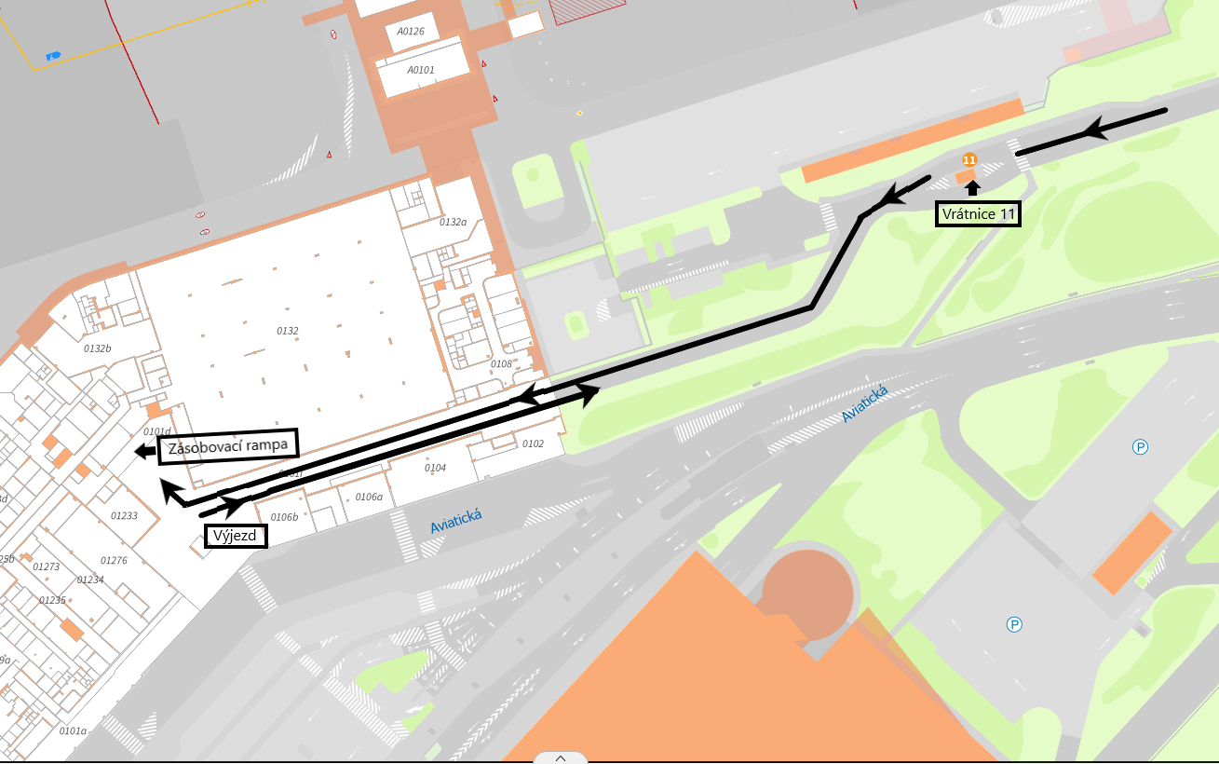
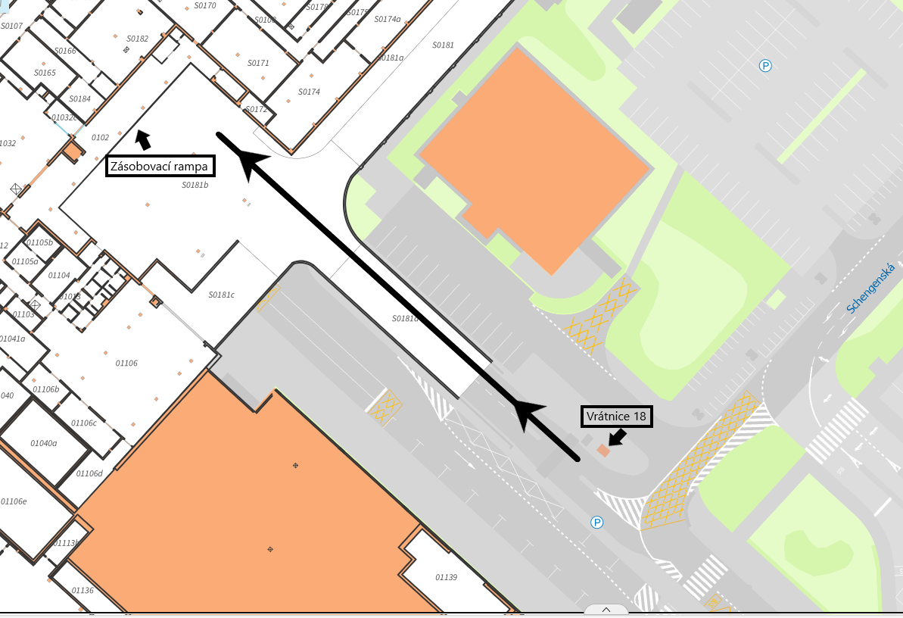
Zásobování – FAQ
Store Stocking - FAQ
FAQ Nr. 1: Where are the service entrance for the supply vehicles?
Service entrances to the freight/load ramps are following: Service Entrance Nr. 11 (Terminal 1) and Service Entrance Nr. 18 (Terminal 2)
TERMINAL 1
TERMINAL 2
Service Entrance Nr. 11
Freight Ramp
Freight Ramp
Exit
Service Entrance Nr. 18

Slide 12
Zásobování - FAQ
Store Stocking - FAQ
FAQ Nr. 2) It is possible to borrow the technical equipment such as forklifts or pallet jacks to unload the truck and then to transport the goods to the retail unit/warehouse?
Prague Airport does not borrow this equipment, it is necessary to have your own equipment for unloading and transporting the goods. Please note that pallet jacks and other technical equpiment for transporting the goods inside of the terminals must have rubber wheels.
FAQ Nr. 3) How is processed the security checks of the oversized goods on pallets that does not fit into the X-ray machine (e.g. Pallets transporting furniture)?
If you have oversized goods that does not fit into the X-ray machine, then the goods must be inspected by pyrotechnicians (a special service needed to be ordered in advance). Please arrange the delivery of the oversized items altogether, preferably just at once (not repeated partial deliveries). This type of deliveries can only be carried out at night (since 10 p.m till 7 a.m.) to minimize the handling of the goods on pallet jacks among passengers. This type of delivery needs to be reported us at least 3 days in advance so that we are able to discuss the details of the delivery with the Airport Ops. and Security departments.
FAQ Nr. 4) What are the options for disposing of larger amount of waste associated with unpacking of the goods? (e.g. plastic; cardboard or wooden pallets):
For the disposal of a larger amount of waste associated with the unpacking of the goods is fully responsible the tenant. Alternatively, it is possible to transfer the waste to the Prague Airport waste collection area by prior arrangement, in this case please contact:
Mrs. Petra Žáková – Waste Management & Veterinary Border Control Station Manager,
tel.: 724 533 286, e-mail: petra.zakova@prg.aero
Please note, that dumping waste on the freight/load ramps or depositing it in the Prague Airport waste collection area without prior arrangement is not permitted.

Slide 13
Odpadové hospodářství
Waste Management
Options for disposing of larger amount of waste associated with the tenant’s activities in business unit (e.g. larger packaging, disposed furniture etc.)
For the disposal of waste associated with the tenant’s activities is fully responsible tenant
The tenant may contact Prague Airport Waste Management Department and arrange specific terms for waste disposal in particular cases. Prague Airport is the authorized person for waste collection according to the Waste Act.
Common types of sorted municipal waste which are handed over by the tenant (e.g. waste from cleaning the business unit) to the central waste storage LP T1 and T2:
Paper, plastic, glass, metal, beverage cartons, mixed municipal waste and kitchen biowaste
The originator of these sorted components of municipal waste and mixed municipal waste produced in Terminal 1 and Terminal 2 is Letiště Praha, a.s.
For more information on Waste Management at Prague Airport and current prices please contact:
Mrs. Petra Žáková – Waste Management & Veterinary Border Control Station Manager
tel.: +420 724 533 286
e-mail: petra.zakova@prg.aero
It is strictly forbidden to dispose of waste outside the designated waste collection points.

Slide 14
Kontaktní osoba a důležité informace
Additional Important Information
Access to the online B2B web portal of Prague Airport
Upon signing the lease agreement, we will give you the access credentials to the B2B web portal dedicated to our business partners. At this web portal you will find additional important information that is regularly updated.
Please note that the access to the B2B web portal is intended only for you, therefore please do not share your access credentials with anyone unauthorized.
Web link to B2B web portal:
https://www.prg.aero/protected-page?destination=/pro-obchodni-partnery&protected_page=29
If you need any other advice or further assistance do not hesitate to contact your designated Key Account Specialist from the Commercial Activities Department ☺.

Slide 15
Kontaktní osoba a důležité informace
List of Attachments – Forms and Manuals
Forms:
Žádost o podpisové oprávnění (Application for Signature Authorization)
Objednávkový formulář služby - vjezdy/vstupy (Order Form for Services Related to entry in the Prague Airport area)
Žádost o zařazení do seznamu dodavatelů (Request for Inclusion in the List of Suppliers)
Objednávka RTG kontroly zboží (Order form for the security check of goods)
Manuals:
Rules for Construction Works at Prague Airport

